Slide 1
Web Programming
Node - Deployment & Dockerization
Lecture 28
Mahhek Khan
Notes:
.

Slide 2
What is Dockerization
Dockerization is the act of creating a Docker image for your application (like a MERN stack app), and then running it inside a Docker container.
A Docker image is a read-only template that contains everything needed to run an application, including:
The application code
Runtime (like Node.js)
Libraries and dependencies
System tools and settings

Slide 3
Why Dockerization
Consistency across all environments (development, testing, production).
Isolation of dependencies — avoids "it works on my machine" issues.
Portability — run anywhere Docker is installed (Windows, Linux, cloud).
Scalability — easy to spin up more containers.

Slide 4
Steps in Dockerization
1. Write a Dockerfile:
Defines how your app is built and run in the container.
Example (Node.js)
FROM node:18
WORKDIR /app
COPY package*.json ./
RUN npm install
COPY . .
EXPOSE 5000
CMD ["node", "index.js"]

Slide 5
Steps in Dockerization
2. Build the Docker image:
docker build -t my-app .
You run it any time you change things that affect the image like you started using jwt token
3. Run the container:
docker run -p 5000:5000 my-app
First time or after docker build or everytime you stop container and start again

Slide 6
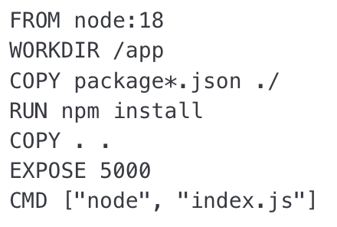
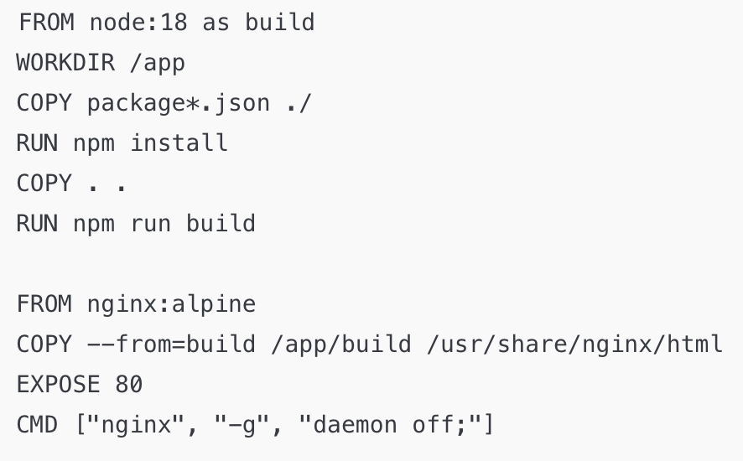
Dockerization
Create separate Dockerfiles for Node.js (backend) and React (frontend), but not for MongoDB, because MongoDB already provides an official Docker image that you can use directly.
Node
React

Slide 7
Mongo (no docker file needed)
Use the official MongoDB image in your docker-compose.yml:
mongo:
image: mongo
ports:
- "27017:27017"
volumes:
- mongo-data:/data/db

Slide 8
Node Dockerfile
1.This tells Docker to use the official Node.js version 18 image as the starting point. It includes Node.js and npm pre-installed on a lightweight Linux system.
2. Sets the working directory inside the container to /app.
3. Copies package.json and package-lock.json (if it exists) into the container’s /app directory.
4. Runs npm install inside the container, installing all Node.js dependencies listed in package.json.
5. Copies everything from your local folder (where this Dockerfile is) into the working directory /app in the container.
6. Informs Docker that the app listens on port 5000. This doesn’t actually open the port

Slide 9
Package.json
{
"dependencies": {
"express": "^4.18.2",
"jsonwebtoken": "^9.0.0",
"mongoose": "^7.0.0"
}
}
You don’t need to run npm install express or npm install jsonwebtoken again manually.

Slide 10
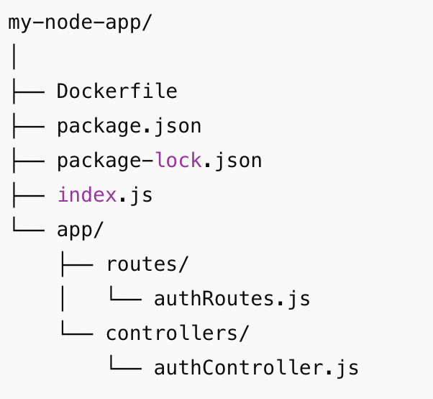
Project Structure

Slide 11
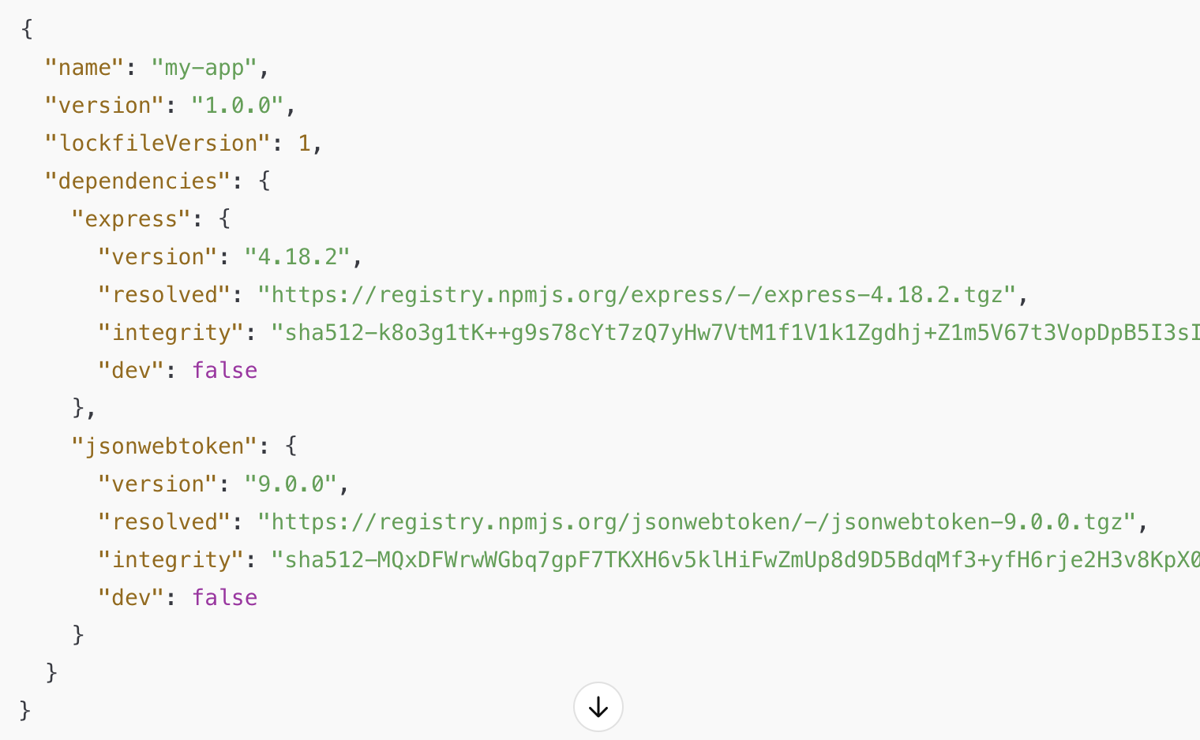
Package-lock.json
The package-lock.json is essentially a "snapshot" of the installed dependencies and their specific versions at the time of the npm install. It records the exact versions, dependency tree, and URLs for the packages that were installed.

Slide 12
Deployment
Deployment is the process of taking your application from your development machine and making it available for others to use, usually on the internet.
When you're building a website or app (like a MERN app), you're writing code on your own computer. But for others to use it (e.g., visiting your site in a browser), it needs to run on a public server. Deployment is how you get it there.a

Slide 13
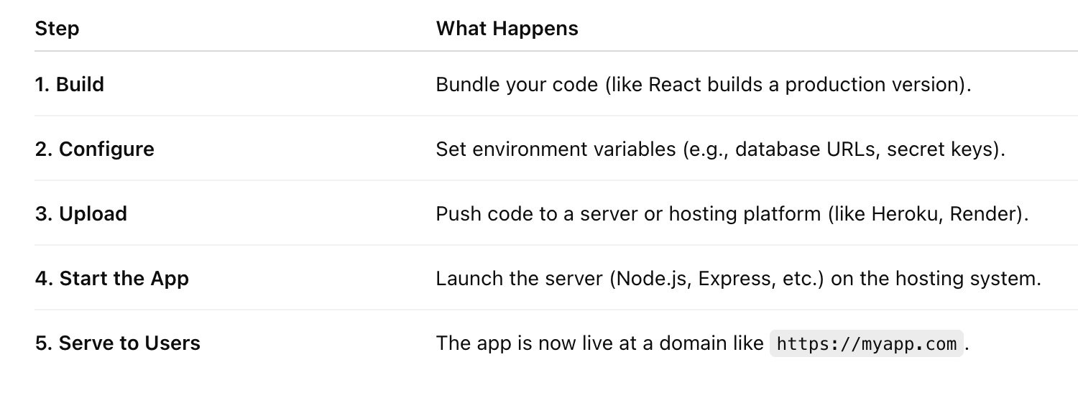
What deployment involves?
Deployment is how you make your app live and usable by the public.

Slide 14
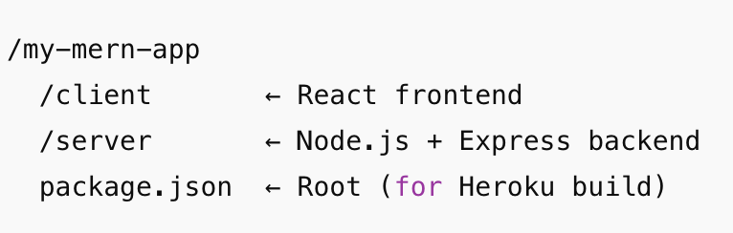
Heroku a use case

Slide 15
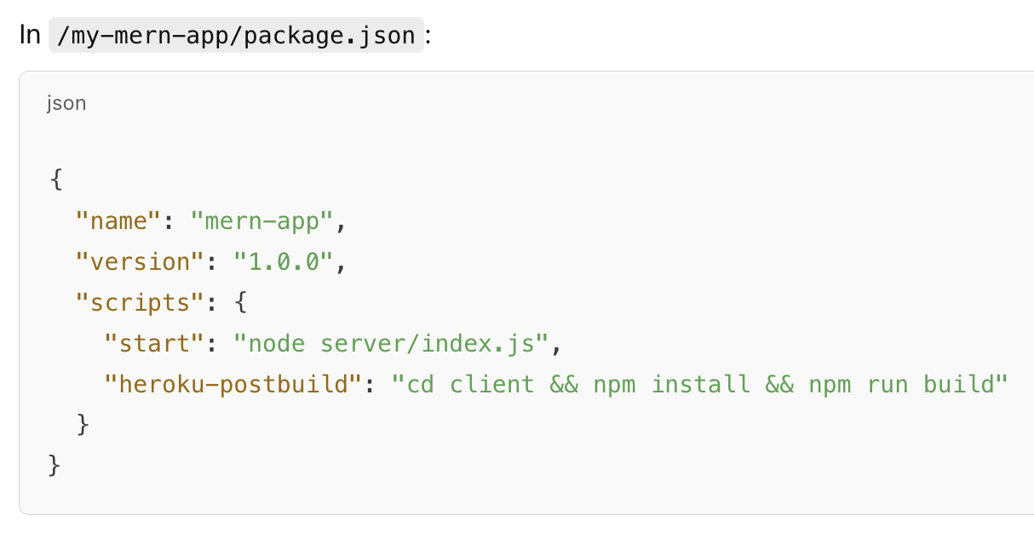

Slide 16
Steps
1. Initialize Git
git init
git add .
git commit -m "Initial commit"
2. Create Heroku App
heroku login
heroku create my-mern-app
3. Create MongoDB Atlas Account and add the string in environment setting
https://www.mongodb.com/cloud/atlas
4. Push to Heroku
git push heroku master
5. Open your deployed app
heroku open

Slide 17
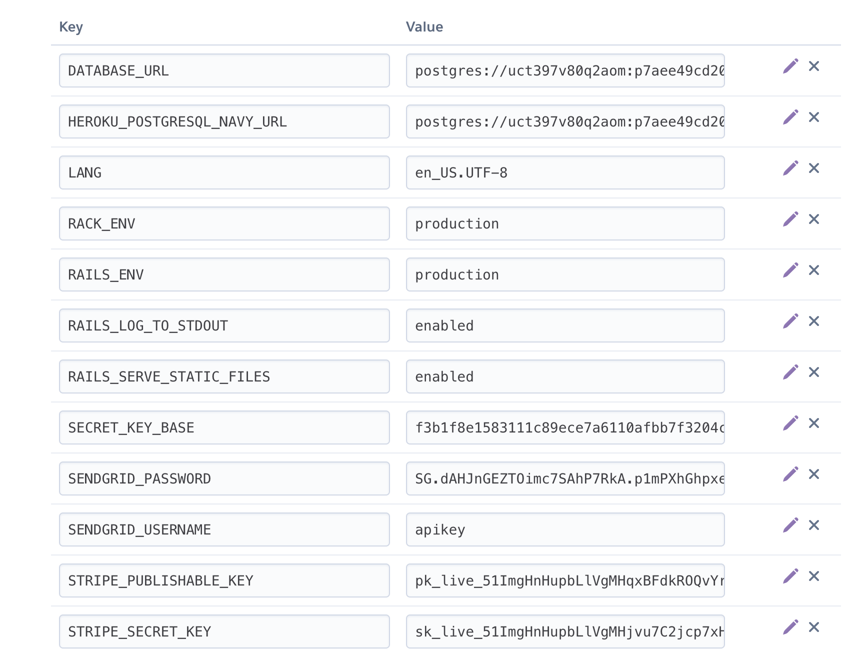
Environment Variables on Heroku
https://dashboard.heroku.com/apps/app-name/settings

Slide 18
Example heroku account

Slide 19
Thank you
Good luck with everything! :)))

